Slide 1
To start with
I disagree with everything he said
Keeping promises is important ☺

Slide 2
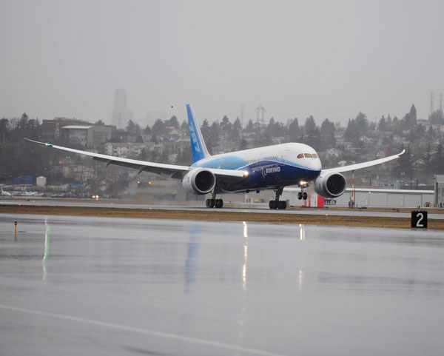
Pilot Monitoring: A manufacturer’s perspective
Capt. Philip Adrian
Chief Pilot Regulatory Affairs
The Boeing Company
Co-Chair of ICAO LOCART
These commodities and technologies are exported from the United States in accordance with the Export Administration Regulations (EAR). Diversion contrary to U.S. law is prohibited. Items are authorized for export by the following Export Control Classification Numbers - No License Required (NLR). Reexport of these Items are not allowed without formal approval from Boeing.

Slide 3
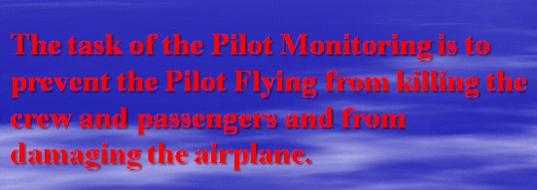
Pilot Monitoring: A manufacturer’s perspective
Capt. Philip Adrian
Chief Pilot Regulatory Affairs
The Boeing Company
Co-Chair of ICAO LOCART

Slide 4
Agenda
Pilot Monitoring
Tasks and Duties
Training
Regulatory Framework

Slide 5
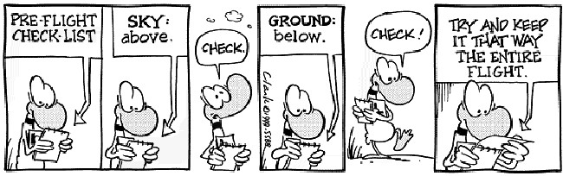
What are we trying to achieve?
Sometimes, we make simple things very complicated

Slide 6
Pilot Monitoring
The Pilot Monitoring (PM) role is not really clearly defined, so let me try to simplify it:
The task of the Pilot Monitoring is to prevent the Pilot Flying from killing the crew and passengers and from damaging the airplane.
(and taking the blame for any bad landing of course)

Slide 7
How do we eat that elephant?
As always, we need to do this one bite at a time…….
So let’s start with the following questions:
How did the Pilot Monitoring position start?
What is the difference between Pilot Not Flying and Pilot Monitoring?
What are the Pilot Monitoring Tasks and Duties?
What is the difference between Active and Passive Monitoring?
How do we train monitoring?

Slide 8
Pilot Monitoring: a little history
Initially, airplanes were flown by a single pilot. Wilbur watched Orville, but didn’t necessarily monitor him.
When operations became more complicated, a second pilot was added to the flight deck
When going from single pilot operation to multi-pilot, little or no task sharing was used or introduced to support this significant change. Pilots essentially had independent tasks that were performed in parallel. There were few defined coordination tasks.
The second pilot role was not defined and the input from the second pilot was often ignored or ridiculed, a causal factor in several incidents and accidents

Slide 9
Pilot Monitoring: a little history
When airplanes became more complex, three-man flight decks were introduced. Often the Captain (normally the “Flying Pilot”) and the engineer (“Master of all technical issues”) where the prime contributors
With three-man flight decks, there possibly was more coordination between the Captain and the Flight Engineer than between the pilots, and an additional factor has been that First Officers often were not trained to similar levels/standards as Captains, and might not even been rated.
CRM training was a direct result of this poor definition. They had to “make” the Pilots communicate and work together.

Slide 10
Pilot Not Flying or Pilot Monitoring?
Initially called “Pilot Not Flying”, identifying only what they did NOT do, the transition has been made relatively recent to use the name “Pilot Monitoring”.
Even though this indicates a higher level of incorporation into the operation, specific training of tasks expected from the monitoring pilot is rarely seen.
This effort was largely driven by the US and the work of Robert Sumwalt when he was at US Airways.
Most presenters seem to be talking about the FO, but both pilots must be able to assume the role of the PM.

Slide 11
Agenda
Pilot Monitoring
Tasks and Duties
Training
Regulatory Framework

Slide 12
Pilot Monitoring Tasks and Duties
Pilot Monitoring tasks and duties are normally identified by OEM’s and/or operators in Standard Operating Procedures
The PM’s Task and Duties vary, and include, but are not limited to:
monitoring instrumentation
making procedural call-outs, normally separated between Normal and Non-Normal
Create and maintain Situational Awareness
Support for Pilot Flying
Identify (significant) deviations
Call out failures or abnormal indications
Perform Checklists
Complete paperwork
Etc…

Slide 13
Pilot Monitoring Tasks and Duties
From a manufacturer’s perspective, the PM is an integral part of the operation, which is not reflected in the current operator and regulatory requirements for training.
To disagree with previous speakers, who only seem to identify the role of the PM as very important in Non Normal situations, it should be stressed that proper monitoring habits should be created and maintained in Normal Operations, and then carried over.
In addition, monitoring in itself is not sufficient, intervention strategies need to be developed.

Slide 14
Pilot Monitoring Tasks and Duties
Areas of Responsibility
Tasks are identified by role (rather: seating position and rank) when the airplane is stationary, but when the airplane is in motion, roles are identified by Pilot Flying and Pilot Monitoring responsibilities.
Tasks are routinely performed by each pilot as part of their normal routines, and understanding of both Pilot Flying and Pilot Monitoring tasks is therefore created. Understanding is the basis of knowledge needed to properly perform any task.
Checklist instructions identify what pilot initiates a Procedure or Checklist

Slide 15
Active versus Passive Monitoring
Through ICAO LOCART testimony, we learned that passive monitoring (exceedance call-outs, no or limited interaction and acceptance of information) has led to or exacerbated events. A proposal to ICAO is to enhance the task of PM and to improve training, and OEM’s coordinated on adding specific PM actions.
LOCART proposal to standardize actions to prevent and recover from upsets are crew based, not skill based

Slide 16
Active versus Passive Monitoring
We have seen many accidents where the airplane was monitored all the way to the impact site. Looking at the wrong thing is not monitoring. It becomes monitoring when priorities are set, and appropriate action is taken.
Therefore, the simple conclusion must be:
Just monitoring is not sufficient!!!
We need to create a link between the monitoring task and the actions that result from it. Active monitoring prevents safety risks.

Slide 17
How are we doing???
I have been missing the discussion on cultural background and cockpit hierarchy:
many accidents have happened with a senior pilot (Chief Pilot, Instructor/Examiner, former Generals, etc.) as PF, with young or inexperienced FO's unwilling or unable to get their message across.
Others have shown "2 PM's" on the Flight deck.
Are we doing as well with CRM as we think we are, or are we paying lip service?

Slide 18
Agenda
Pilot Monitoring
Tasks and Duties
Training
Regulatory Framework

Slide 19
Pilot Monitoring Training
Training is focused on piloting skills, where the PM is used for exceedance protection. With complexity of airplanes higher, duties longer and distractions galore, the PM is an essential safety net, and should be trained as such.
Monitoring and cross-checking are perceived as important piloting skills and should be explicitly trained and practiced in the training environment.
Pilots need to know what to dedicate their attention to and when, and how to turn data into information that is relevant to the current activity. Just knowing what to look at is not enough.
Pilots need to be trained to manage secondary task loading so that monitoring is not dropped for competing demands. In training, monitoring should be emphasized as a primary task and pilots must be given strategies for managing workload in all flight phases so that monitoring is not dropped inappropriately.

Slide 20
Pilot Monitoring Training
So how can we improve: We must change the paradigm!
Low hanging fruit is to randomly change the pilot task during sim sessions.
Pilot Monitoring training will need to be specific, identifying essential skills and threats.
Scenario based training will be required, with not only actions for the Pilot Flying as traditionally trained, but with identified tasks for the Pilot Monitoring.
CRM has to be effective and properly trained, not just paid “lip-service”.
Sim IOS should have “confederate” powers for MCP selections, and have the ability to disable alerts that currently “save” the PM.

Slide 21
Agenda
Pilot Monitoring
Tasks and Duties
Training
Regulatory Framework

Slide 22
Regulatory Requirements
Regulatory requirements are focused on individual (piloting) skills minimum training
Part FCL: Flight Crew Licensing
Part ORO:
Recurrent Pilot Training
CRM initial and recurrent training
OEB/FSB

Slide 23
Regulatory Requirements
Regulatory requirements focus on individual (piloting) skills and on “CRM”, without providing guidance on or requiring training for the Pilot Monitoring
Part FCL: Flight Crew Licensing identifies task for “airplane control”
CRM initial and recurrent training identifies crew interaction etc without identifying tasks or roles for PM
OEB/FSB focused on skills of flying the specific airplane based on technical differences (ODR/MDR)

Slide 24
Regulatory Requirements
Regulatory requirements are normally used as the minimum training requirement for operators and training organizations to minimize budget impact.
Training is generally still seen as a cost
Flight Test Schedules are written to identify and check individual skills, and “CRM” is generally only used as a generic measure.
This way the PM is at the mercy of the PF, and the issue becomes that with an “ace” pilot, the PM task becomes less important except for scripted tasks. This is until the PM becomes critical!

Slide 25
Closing remarks
Pilot Monitoring Tasks and Duties are well defined by OEMs and operators, but are not always properly trained and understood.
Regulatory requirements on PM training will be needed to change this to enforce, rather than trust the right thing to be done voluntarily by OEMs or Operators
Operators should place emphasis on crew skills, not only on piloting skill, and should emphasize expectations and properly train the PM to not only monitor, but to intervene when necessary

Slide 26
If you think monitoring the PF is difficult…
The Air Force has created a system that monitors itself
SitAw Monitoring

Slide 27
Questions?
Thank you
Capt. Philip Adrian
Chief Pilot Regulatory Affairs
The Boeing Company
Co-Chair of ICAO LOCART
Philip.Adrian@boeing.com

